Slide 1
Behaviour in settlement negotiations
AML – what will you need to do
Naomi Fink, Lawyer, Holley Nethercote
Matthew Rose, Risk Manager, LPLC

Slide 2
Overview
Background to the AML / CTF regime
Explanation of money laundering and terrorism financing
AML / CTF obligations
How will the AML / CTF regime apply to lawyers?
Examples of ML / TF risks for lawyers
The New Zealand experience: examples of red flags

Slide 3
Background to the AML / CTF regime
Australia is a member of the Financial Action Taskforce on Money Laundering (FATF)
AML / CTF Act commenced in 2007
Types of businesses caught by the AML / CTF regime
Examples of designated services
Expansion of coverage to include ‘designated non-financial businesses and professions’ (DNFBP) - includes lawyers, real estate agents and accounts

Slide 4
What is money laundering and terrorism in financing (ML / TF)?
Money laundering is disguising the illegal origins of money
Investing in legitimate businesses
Structuring
Using overseas banks
Terrorism financing – using legitimate or illegitimately sourced funds to finance terrorism
Funding the direct costs of terrorism
Financing a terrorist organisation

Slide 5
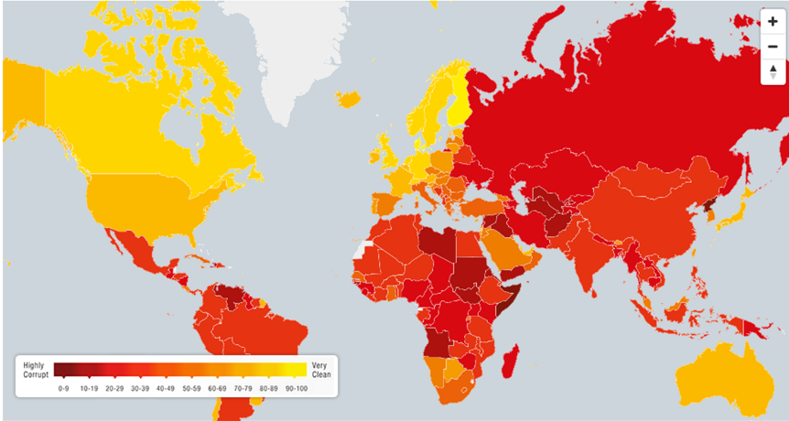
Jurisdiction – the role of place

Slide 6
Overview of AML / CTF obligations (1)
Enrol with Australian Transaction Reports and Analysis Centre (AUSTRAC)
Governance and management oversight
ML / TF risk assessment (categories of risk)
Training
Employee due diligence
Record keeping
Independent review

Slide 7
Overview of AML / CTF obligations (2)
Risk-based customer identification and verification - know your customer (KYC)
Ongoing customer due diligence (transaction monitoring, enhanced customer due diligence)
Reporting obligations
Suspicious matter reports (SMR)
Annual AUSTRAC compliance reports
Threshold transaction reports

Slide 8
How will the AML / CTF regime apply to lawyers?
Proposed new designated services – management of, giving tailored advice, or making arrangements in relation to:
sale of business
formation of company
debt or equity finance for a company
creation of trust or partnership
management or day to day operations of an entity
acting as a director or officeholder or a company
providing a registered office
nominee shareholder

Slide 9
Examples of ML / TL risks for lawyers
Providing advice or assisting with company and trust formation services (complex structures)
Buying and selling of real estate or legal entities (source of funds)
Trust account – payment to third parties (remittance)
Setting up and managing charities (TF risk)
Acting as, or arranging for someone to act as a nominee or director or trustee (perception of legitimacy)
Lodging of SMR

Slide 10
The New Zealand experience: examples of red flags (1)
Misuse of trust accounts
Use of trust account with no underlying legal work
Aborting transaction after receipt of funds – unexplained request to send funds to a third-party
Purchase of real estate
Funding is from cash
Source of funds is unclear, or inconsistent with client profile

Slide 11
The New Zealand experience: examples of red flags (2)
Creation of trusts and companies
Use of intermediary without good reason
Involvement of high risk countries
Management of trusts and companies
Attempts to disguise or obscure the beneficial owners
Use false identity documents
Managing client affairs and making introductions
Client requires introduction to access banking facilities
Client is a politically exposed person (PEP)

Slide 12
The New Zealand experience: examples of red flags (3)
Undertaking certain kinds of litigation
Client has known or suspected links to organised crime
Litigation is settled very quickly, even before any legal services provided
Setting up and managing charities
NFP entity engages in non-typical transactions
Attempts to obscure parties to a transaction

Slide 13
Naomi Fink Lawyer Holley Nethercote
www.hnlaw.com.au
Melbourne Office T: +61 3 9670 8200 Level 22, 140 William Street GPO Box 3045 Melbourne, VIC 3001 Sydney Office T: +61 2 9238 2145 Suite 42 Level 57, MLC Centre 19-29 Martin Place, Sydney, NSW 2000

