Slide 1
Behaviour in settlement negotiations
Reducing the risk of difficult clients
An ethical approach
Ronwyn North, Managing Director, Streeton Consulting
Matthew Rose, Risk Manager, LPLC

Slide 2
Session Aim and Outline
Aim: To better recognise ‘difficult’ clients and deal with them more effectively to reduce risk of claims, stress and breach of ethical obligations
Outline: 1. What are ‘difficult’ clients and how they are risky and ethically challenging 2. Four degrees of difficulty 3. Ten practical strategies 4. Summing up

Slide 3
1. What are ‘difficult’ clients?
Hard to help, please, like or do your best for
Think, react, behave counterproductively both to their own interests including relationship with you
Relationship unrewarding for you
Professionally, financially, personally

Slide 4
‘Difficult’ clients are risky
Claims/complaints risk
‘I knew this client was trouble from the beginning’
Failure to take extra safeguards or troubleshoot effectively
Employer liability risk
Duty of care to provide a safe, equitable working environment
Aggressive, abusive, harassing, bullying behaviour can induce stress and psychological injury

Slide 5
Difficult clients can be ethically challenging
Difficult behaviour creates ethical strain
Tempt or provoke you into compromising your legal or ethical duties eg:
Exceed or ignore instructions
Make questionable assertions
Write threatening letters
Tell white lies
Be discourteous

Slide 6
Ethical strain – someone ends up in the mud Make sure it isn’t you!

Slide 7
2. Four degrees of difficulty – most difficult for you?
Situational Factors
Personality
Behaviour
Impaired
Different
from you
Thoughts
Age
Gender
Tough
Customers
Feelings
Culture

Slide 8
Situational factors – familiar red flags
Triggers for careful screening or extra safeguards without having to get ‘up close and personal’ eg:
‘Difficult’ in past, changing lawyers, litigious
Price driven
Financial difficulty
Difficult to contact (eg. overseas)
Special needs (eg. language, vulnerable)
Legal or life crisis

Slide 9
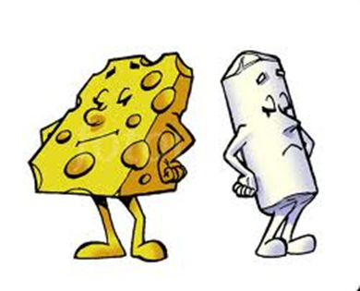
Different from you
Personal differences can get in the way of a constructive working relationship
Personality clashes
Gender wars
Generation gaps
Cultural, ideological or social differences

Slide 10
Different from you
To reduce risk of relationship conflict
Be more self aware and open to other perspectives
Interpersonal skills training
Value diversity and make it work for you

Slide 11
Impaired by mental illness; most difficult of the difficult A job for experts, not dabblers
Sources of incapacity
Acquired brain injury
Addiction
Depression
Dementia
Querulous paranoia
200+ classified mental illnesses and personality disorders
Not your job to be therapist, but you can:
Consider possibility of incapacity
Follow guidelines
Develop your skills
Involve other professionals

Slide 12
Tough customers can’t see their counterproductive, entrenched patterns of thoughts, feelings and behaviours
Types of behaviour:
Needy
Emotional
Demanding
Undemanding
Uncooperative
High conflict
Lack insight into unhelpful impacts because they get other payoffs.

Slide 13
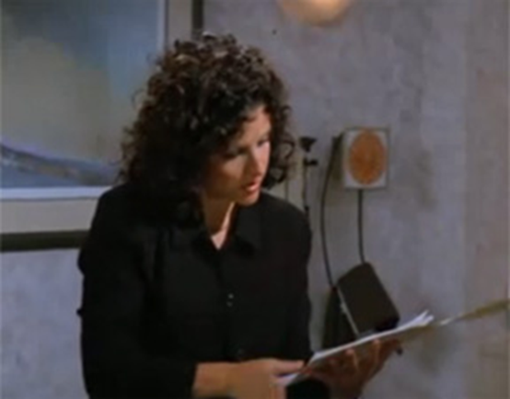
Mistake to tell a client they are difficult but you can learn how to understand and influence them better
Strengthen your:
Processes
Skills
Mindset

Slide 14
Most difficult for you?
Situational Factors
Personality
Behaviour
Impaired
Different
from you
Thoughts
Age
Gender
Tough
Customers
Feelings
Culture

Slide 15
3. Ten practical strategies to better manage difficult clients
Assess ‘degree of difficulty’ of all new clients
Say ‘no’ nicely
Do what you know you should be doing
Extra safeguards for ‘tough customers’
Seek feedback from staff and clients
Stand your ground
Keep your cool
Check you’re not being a difficult lawyer
Terminate ethically
Look after yourself

Slide 16
3.1 Assess ‘degree of difficulty’ of all new clients
Look for special risk factors
Any reason to think this client will be difficult?
How certain are we this client won’t be difficult?
Ask questions and collect information sufficient to make an informed intake decision
Prompts in instruction sheets
Sign off that ‘degree of difficulty’ has been considered

Slide 17
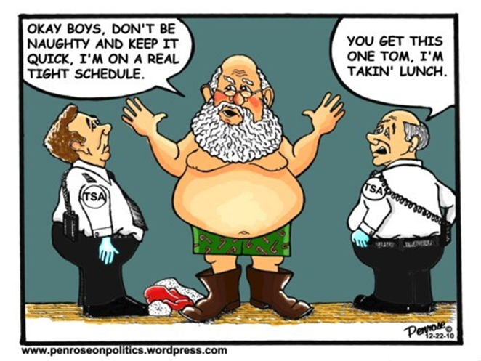
No exceptions!!

Slide 18
3.2 Say ‘no’ nicely – and legally and ethically
No ‘cab rank’ rule for solicitors but consider:
Unlawful discrimination (in fact or perception)
Moral duty to accept
“Are we the right lawyers for you?”
Help clients screen themselves out
Be tactful in communicating decline decisions
Reputational risk from mishandling
Potential referrals from good handling

Slide 19
3.3 Do what you know you should be doing Basics could save you if client is difficult later
Who is/not client?
Scope/exclusions
Fee disclosure and accurate estimates
Costs agreement or engagement letter
Informed consent to conflicts
Money on account
Detailed instructions
Explain legal process
Keep client updated
Keep matter moving
Keep good records
Interim billing
Prompt billing
Check satisfaction

Slide 20
3.4 Extra safeguards for ‘tough customers’ Start how you mean to finish
Check expectations
Push back at outset
Don’t over-promise
Set boundaries eg:
Availability
Communication
Co-operation
Price appropriately
Premium must be justified
Allow more time
Communications
Supervision
More defensive records
Signed costs agreement/letter
Written instructions
Witness/note taker
Confirmations

Slide 21
3.5 Check safeguards are working Seek feedback from staff and clients
“How is relationship with (with client)?”
Staff may not speak up
Proper supervision not corridor conversations
“I’d like to talk about our relationship …”
“Are we meeting your expectations?”
“You seem upset. Is there something we should talk about?”
“I am concerned about … (situation/specific behaviour) and would like to know how you see things working out”

Slide 22
3.6 Stand your ground, reinforce boundaries and limit the number of ‘second chances’
Bring difficult behaviour into the open and agree action. Be specific, positive, clear, non-judgmental about what you need the client to do (or stop doing) and the consequences.
“It seems you have a different view. Let me explain. I can make suggestions for you … these are your options … one option for you is …”
“I am on your side. For me to help I need you to … (do task or stop unacceptable behaviour). If you cannot (do/stop) then the consequences for (your matter/our relationship) will be …”

Slide 23
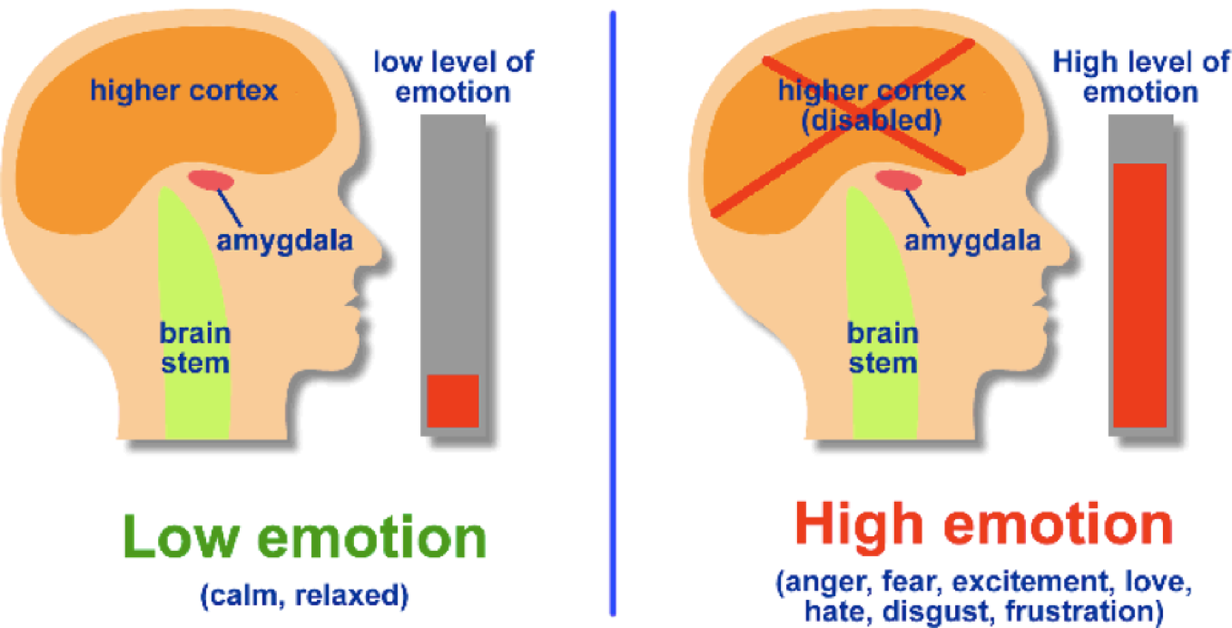
3.7 Keep your cool. Practise professional detachment
Learn to recognise the signs of impending Amygdala highjack – in yourself and others

Slide 24
3.7 Keep your cool – how to deal with (a client’s) high emotion
Stay calm, be professional, don’t take it personally
Control your inner dialogue and body language
Show you care. Be attentive, empathic, respectful
Reengage rational brain with factual Q&A
Refocus attention on steps, goals, benefits
Walk it off, take a break, reschedule
Be safe. Do not accept or tolerate abusive or aggressive behaviour

Slide 25
3.8 Check you’re not being a difficult lawyer Be honest about it – a difficult client may have a valid gripe
Truly client focused?
Trustworthy?
Easy to deal with?
Able to take criticism?
Willing to apologise?
Willing to change?

Slide 26
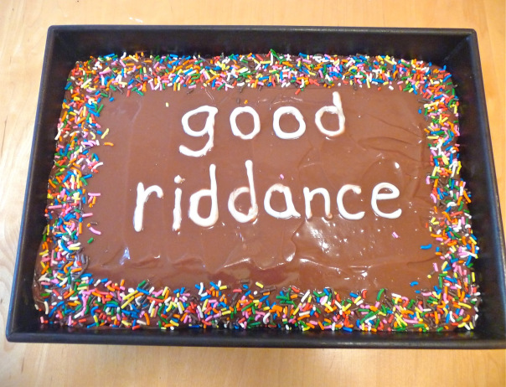
3.9 Terminate ethically
“Some cause happiness wherever they go.. Others whenever they go!” (Oscar Wilde, Duchess of Padua)

Slide 27
3.9 Terminate ethically – ASCR Rule 13 Exceptions to duty to complete the work
Client terminates (r13.1.2)
“Am I still the right lawyer for you?”
Mutual agreement (r13.1.1)
“Should we agree you’ll find another lawyer?”
Lawyer terminates for just cause and on reasonable notice (r13.1.3)
“I need you to find another lawyer”

Slide 28
Effective termination requires careful thought and preparation to reduce risk of harm to client and firm
Consider legal, ethical, client and firm impacts
Termination clauses in terms of retainer
Just grounds, reasonable notice, special considerations
Work to be completed
Disengagement letter and final bill
Handover of file and documents. Lien or not?
Risk of negligence allegations if may sue for fees
Who will deliver the news, when and how?

Slide 29
3.10 Look after yourself Self care allows you to better care for others
Develop and practise
Professional detachment and resilience
Positive mindset
Sense of self confidence, self worth
Capacity to ‘disagree well’
Relaxation and mindfulness
Share the load
‘Only one sleepless night then talk to someone’

Slide 30
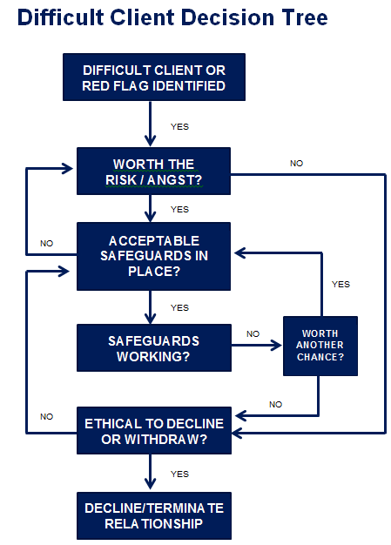
4. Summing up practical strategies Decision tree to help screen, manage, terminate

Slide 31
Last word – what are you taking away from today?
Any insights?
Who are difficult clients for you and why?
Risks and ethical exposures posed by your difficult clients ?
Actions you can take to strengthen your approach?
Processes
Skills
Attitudes
Safe practice!

Slide 32
References and resources
Dealing with difficult clients. Carol Curtis 2004
https://www.lawpro.ca/LawPRO/DifficultClients.pdf
HBR The Secret to Dealing With Difficult People: It’s About You - Tony Schwartz October 12, 2011 https://hbr.org/2011/10/the-secret-to-dealing-with-dif.html
Is Professional Detachment Good or Bad? - Andy Mergendahl on August 9th, 2012
https://lawyerist.com/is-professional-detachment-good-or-bad/
How to repel the wrong kind of client
https://www.legalfutures.co.uk/latest-news/design-your-website-to-repel-wrong-kind-of-client

Slide 33
References and resources
It's All YOUR Fault! 12 Tips for Managing High Conflict People by Bill Eddy Published on August 17, 2015 (Book and various blog posts in Psychology Today)
https://www.psychologytoday.com/au/blog/5-types-people-who-can-ruin-your-life/201710/4-biggest-mistakes-high-conflict-personalities
https://www.psychologytoday.com/au/blog/5-types-people-who-can-ruin-your-life/201711/how-quickly-spot-high-conflict-people
Capacity Guidelines 2018 https://www.liv.asn.au/getattachment/Professional-Practice/Areas-of-Law/Elder-Law/Resources/20180125_LIVCapacityGuideToolkit_ConciseEd-PDF.pdf.aspx
Cab rank rule http://www.qls.com.au/Knowledge_centre/Ethics/Resources/Client_instructions_and_capacity/Does_the_cab-rank_rule_apply_to_solicitors

Slide 34
References and resources
Australian Solicitors Conduct Rules and Commentary (See websites of Law Council of Australia and LIV)
LPLC Working together roles and obligations client brochure https://lplc.com.au/client-resources/working-together-roles-obligations-client-brochure/ Be clear as to grounds to terminate a retainer http://www.qls.com.au/Knowledge_centre/Ethics/Resources/Completion_or_termination_of_engagement/Be_clear_as_to_grounds_to_terminate_a_retainer Guidance statement No. 8 – Termination of a retainer http://www.qls.com.au/Knowledge_centre/Ethics/Guidance_Statements/Guidance_Statement_No_8_-_Termination_of_a_retainer

Slide 35
Ronwyn North Managing Director
Streeton Consulting 0414 696 551 rjnorth@streetonconsulsting.com.au

