Slide 3
Solicitor’s certificates
Guarantees (usually third party - Amadio)
SMSF or trustee borrowings
Financial agreements in Family Law
Franchise agreements
More….

Slide 4
Scenario
You are an experienced solicitor with 40 to 50 percent of your work in the banking and finance area. For many years you have been putting together mortgage packages for various lenders and you probably provide about three solicitor’s certificates a year to various clients.
You are asked by a partner of the firm to provide a solicitor’s certificate for a long standing commercial client of the firm and his wife. They are taking out a second mortgage over some property they own.

Slide 5
Scenario
The loan and mortgage documents are sent to you ahead of time and you read and make notes about them before seeing the husband and wife. It is a fairly standard documentation and situation with husband and wife and two companies as the borrowers and part of the security includes the assets of the companies and two properties in the wife’s name.
What issues would you raise at the meeting?

Slide 6
Issues to raise
4 borrowers – joint and severally liable
The assets of the companies and the two properties are the security
If there is a default – higher rate of interest and lender can choose which assets to take, including property
Could lose your property
Mortgages or caveats could be lodged on the titles
Could be in breach of first mortgage by signing this mortgage
If lender lodged caveat you couldn’t sell land until it is removed
Conflict

Slide 7
What happens next?
You take your notes about the documentation into the meeting with the clients. You go through those notes explaining all the issues arising from the documents. You are satisfied they both understand what they are doing and the effect of the documents. They both make comments and ask questions. You are satisfied that the wife knows what is going on.
They sign the loan and mortgage documents and they sign an acknowledgment of having received legal advice and you sign the solicitor’s certificate for them both.

Slide 8
What happens next?
One year and nine months later …
a phone call - to give evidence
the loan is in default
the companies are in liquidation
the husband is bankrupt
the wife is a sole defendant in proceedings brought by the lender to sell her properties.

Slide 9
What happens next?
The wife joins your firm to the proceedings alleging that the only advice you gave her was that:
a loan was going ahead
the effect of the documents was that she could not sell her properties without prior agreement from the lender
the lender would be entitled to “have” a caveat on her properties but they would not actually do that
You never told her she could lose her property

Slide 10
What happens next?
Your file:
the notes you made about the documents before you met with the clients
no note of the meeting
no letter of advice confirming what happened at the meeting.
The difficulties in defending this claim?

Slide 11
The difficulties in defending this claim?
No file note = evidence maybe a reconstruction of what you believed should have happened and not what did happen
You saw the wife with the husband = conflict
No advice the wife obtain full financial information about the husband’s business

Slide 12
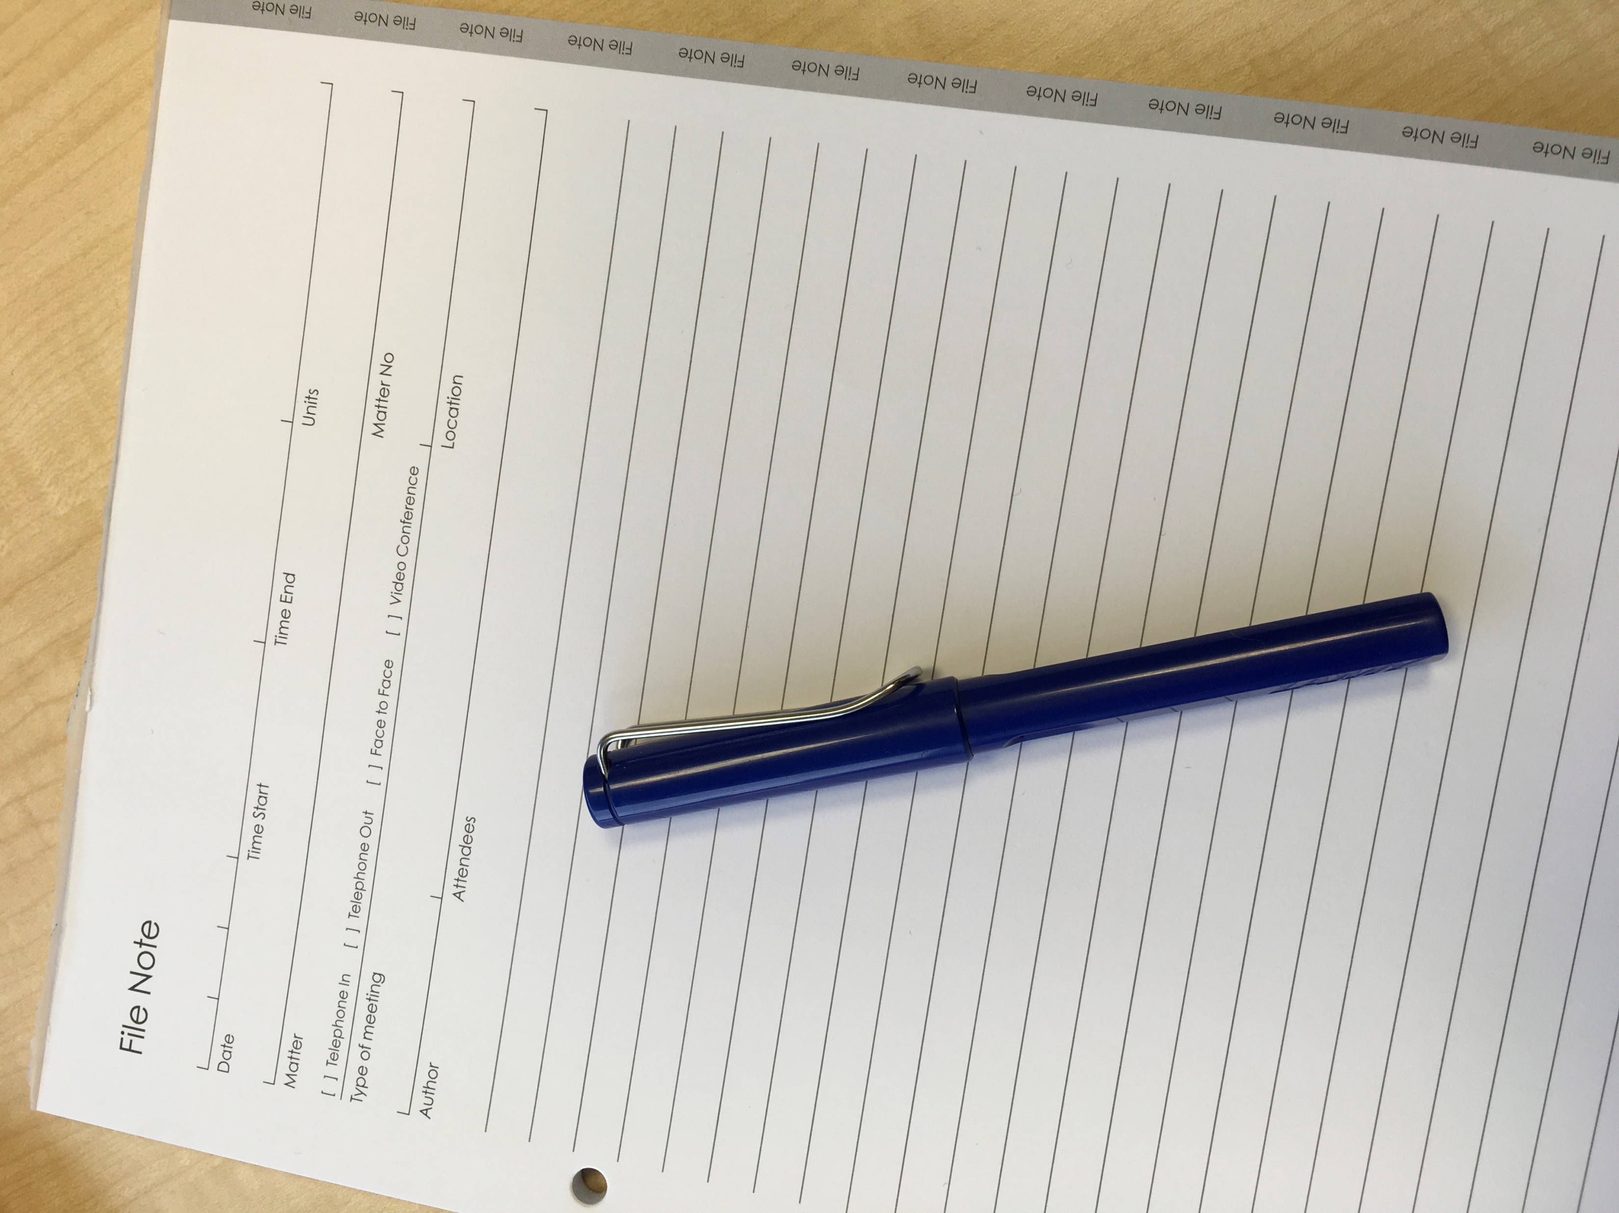
The big issues
Contemporaneous file notes

Slide 13
The big issues
Recognising the conflict
She is sole owner of property being secured
She is not a director of the companies receiving the money
You need to give her robust advice about the risks of entering this arrangement
You need to tell her she should ask for the financial statements of the business.
You need to only act for one of them.

Slide 14
The big issues
Broader advice than just the legal effect
The banking Code of Practice
In Provident Capital Ltd v Papa [2013] NSWCA 36 the court said:
A solicitor’s obligation is not simply to explain the legal effect of documents but to advise his or her client of the obvious practical implications of the client’s entry into a transaction the subject of advice.

Slide 15
The big issues
Communicating your message
How people process information:
Selective attention to avoid overload
https://www.youtube.com/watch?v=IGQmdoK_ZfY
Must have personal significance to “register”
We can’t remember what we don’t understand
We can only remember a few points at once
We don’t remember exactly what was said - we remember our interpretation of what was said (or seen etc)

Slide 16
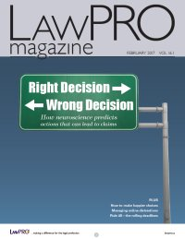
‘Putting your best brain forward’ by Nora Rock, LawPro Magazine: February 2017
(http://www.practicepro.ca/LawproMag/default.asp).

Slide 17
Putting your best brain forward
System 1 - makes decisions described as primal, basic and instinctual - the gut reaction.
System 2 - provides rationalisation for system 1 decisions or overrides system 1 decisions to allow us to revise them.

Slide 18
Putting your best brain forward
Bias
unconscious bias
confirmation bias - clients may be listening to you and trying to reinforce what is already in their own mind
Fight or flight - impairs our ability to think and our memory

Slide 19
Solutions?
Best case
give clients the time to go away and think about it
confirm the information in writing so they can read it and reflect on it, or
record the meeting and let them relisten to it, or
send the client your advice letter before they come in to meet with you
Ask client what they understand the worst case scenario could be?
Amadio Checklist
Precedent file note
Your suggestions?

Slide 20
Current financial themes
Shelf companies and the Consumer Credit Code
Borrowing for joint ventures
Bank of Mum and Dad

Slide 21
[Questions slide??]

