Slide 2
Conveyancing tax issues
Phil Nolan
Notes:
Hi, I’m Phil Nolan.
All the information I want to provide to you today about conveyancing tax issues is in the handout.

Slide 3
How many tax issues do you raise with clients in conveyancing matters?
Notes:
During my session I would like you to think about how many tax issues you raise with clients in a conveyancing matter?
Is it three or 10 or 20?
Does anyone want to guess how many taxes Australians pay???
According to a report by the Federal Treasury in 2010 Australians pay at least 125 different taxes each year. Of these, 99 are levied by the Australian government (including 67 agricultural levies), 25 by the States and 1 (council rates) by local government. The report is known as the ‘Australia’s future tax system’ and can be found on the Treasury website.

Slide 4
Three key points
Develop, use and update a checklist about tax issues
Invest in some good resources on taxes and consult them regularly
Take some time to read cases about taxes
lplc.com.au
Notes:
Today I have three key points to help you avoid a claim about conveyancing and tax issues:
One - develop, use and update a checklist about tax issues
Two - invest in some good resources or current books on taxes and consult them regularly – my two go to books about tax issues are: winning property tax strategies by Julia Hartman and Bruce Whittaker and Foundations of taxation laws by Stephen Barkoczy.
And three - take some time to read cases about taxes
How about the great margarine tax case in the High Court in 1955 about the freedom of interstate trade of margarine.
Let me read a short passage Justice Dixon’s judgment:
they may take our lives, but they'll never take... OUR FREEDOM!
Perhaps these words were said by the great Scottish freedom fighter William Wallace or Mel Gibson in Braveheart
And what about the Guru 4 u tax case.
The ATO cancelled Guru’s GST registration because it did not believe it operated an enterprise.
So what did Guru do?
Guru’s business was to promote peace and harmony.

Slide 5
Take the tax test
Do I have a checklist of tax issues?
Do I have enough tax knowledge to know which taxes may impact on a client’s conveyance?
Do I discuss tax issues with conveyancing clients to enable clients to make informed choices?
Do I refer clients to on-line calculators?
Do I document tax advice to clients in writing?
Do I allocate responsibility for tax issues?
Good, better, best. Never let it rest. Til your good is better and your better best. St Jerome
Notes:
For the next part of my session I would like to do a quick tax test.
You will find this test on page 4 of my handout.
Take a few moments to answer the questions. Put a tick in each box you answer yes.
Now give your self one point for each tick.
Did anyone get 6 points?
Anyone who did not get 6 should refer to my quote from St Jerome – good, better, best. Never let it rest til your good is better and your better best. For those of you who don’t know 30 September is the feast day of St Jerome.
For the balance of my session we will consider the four main taxes which clients need to know about when they are buying and selling land – CGT, GST, Land Tax and Duty.

Slide 6
CGT
Legislation - Income Tax Assessment Act 1997 (Cwlth)
Commencement – 20 September 1985
Aim - To collect tax on any net gain on disposal of a CGT asset
Imposition – Payable as part of income tax
lplc.com.au
Notes:
On page 5 of my materials you will find some CGT basics.
You will recall in 2016 the Government introduced a CGT withholding requirement and in 2017 this applied to any acquisitions of real estate where the market value was $750,000 or more and the withholding amount is 12.5% of the contract price.
According to The Age on 26 July, the ‘Government’ has collected $1 billion in CGT from foreigners since the scheme was introduced in 2016.
When they say ‘Government’ I think they mean you – the lawyers have collected this at settlement and sent to the Government.
The article also said that the Government has forced the sale of over 300 properties owned illegally by foreigners.
To focus on what we see in CGT claims, lets do an exercise.

Slide 7
CGT exercise no. 1
Background
Instructed by two registered proprietors to do two transfers:
Green acre (their principal place) from both to just one of them.
Black acre from both to a self-managed super fund that they are in the process of establishing.
You write to the clients confirming their instructions and make it clear you are not providing any tax advice.
Some months after the transfers are registered the clients contact you saying their accountant recently informed them that CGT is payable. They also tell you, with some anger, that they would not have gone ahead with the transfers if you had explained to them the CGT consequences.
lplc.com.au
Notes:
Here is the background to a CGT exercise. The exercise is on page 6 of my handout:
You act for two registered proprietors who instruct you to do two transfers of land as follows:
Green acre (their principal place) from both to just one of them.
Black acre from both to a self-managed super fund that they are in the process of establishing.
The clients tell you they are doing the transfers on advice from their financial advisor as part of a refinance of their Westpac business loans.
After this initial visit you write to the clients confirming their instructions and make it clear you are not providing any tax advice.
Some months after the transfers are registered the clients contact you saying their accountant recently informed them that CGT is payable. They also tell you, with some anger, that they would not have gone ahead with the transfers if you had explained to them the CGT consequences.
You deny any liability on the basis that you told them you were not providing any tax advice and given that the clients told you they had received advice from their own financial advisor before instructing you.

Slide 8
CGT exercise no. 1
Question
Is there anything more you might reasonably do in this situation about any tax issues?
lplc.com.au
Notes:
My question to you is:
Is there anything more you might reasonably do in this situation about any tax issues?
Perhaps the clients thought preparing the two transfers is a simple and cheap job?
Experienced practitioners know these sorts of transfers are anything but simple and should be treated no differently to an arm’s length conveyance.
One way to re-enforce how complicated such transfers can be is to give the client a list of issues which need to be addressed. Items to consider including on the list are the need to determine the duty payable and capital gains tax, giving notice to various authorities and where relevant dealing with any mortgagee on title.
Doing this will also improve communication with clients as well as comply with rule 7 of the Legal Profession Uniform Law Australian Solicitors’ Conduct Rules 2015 which requires practitioners provide clear and timely advice to assist clients to make informed choices.
I invite you to comment on what you would do differently in this scenario.

Slide 9
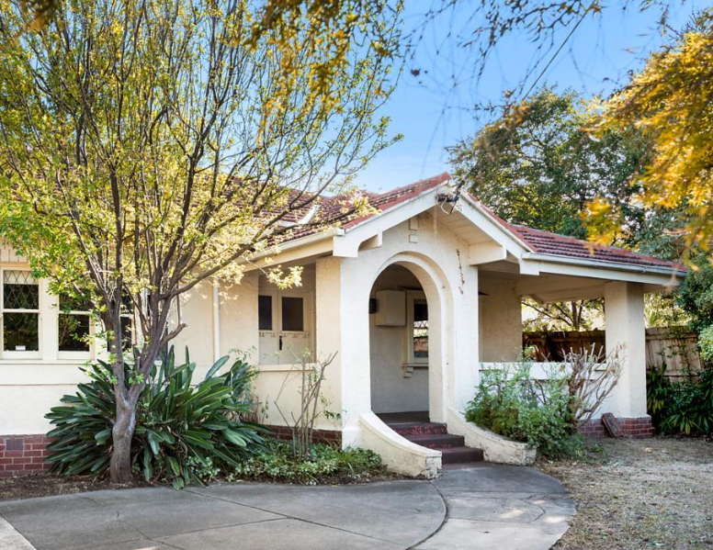
CGT exercise no. 2
25 Doncaster Road, Balwyn North VIC 3104
Proposed sale
Value estimate - $1,200,000
One party a foreigner
Subject to a lease
Home office
Action
List three issues you would raise with your clients about CGT.
lplc.com.au
Notes:
Lets now have a look at our second CGT exercise.
Please refer to page 7 of the handout.
Imagine you act for a husband and wife in the sale of 25 Doncaster Road, Balwyn North. The sale is subject to a lease of a granny flat at the rear of the property currently leased to a University student for $100 a week. The lease expires in 6 months.
The husband is a foreign resident. The wife is an Australian citizen and resident tax payer. The clients tell you that for a few years they have run a business from home providing IT services to medical practitioners.
They tell you they are expecting about $1,200,000 for the property.
You are about to send the draft contract and section 32 statement to them for approval.
Action
List three issues you would refer to in your letter enclosing the documents about CGT.
1. Principal place / main residence exemption – part leased part use as an office. This means the property only qualifies for a partial exemption – main residence.
Renting out part of the home means they are not be entitled to the full main residence exemption from capital gains tax (CGT).
CGT withholding
CGT withholding applies unless a clearance certificate is provided. Ask the client whether they want a clearance certificate.
Estimate of CGT payable
Last time I wanted to sell something, I had about four discussions with my accountant to work out the CGT payable. The accountant wanted all sorts of information to calculate the cost base. The accountant also worked out the losses which could be used to off set the capital gain. Sometimes losses cannot be carried forward so it might make a difference if the client sells before or after June 30.

Slide 10
Any questions or comments?
lplc.com.au
Notes:
Before we move on to look at some GST issues are there any more questions or comments about CGT?

Slide 11
GST basics
Main legislation: A New Tax System (Goods and Services Tax) Act 1999 (Cwlth).
Commencement: 1 July 2000.
Imposition: 10 per cent value added tax payable on most goods and services. Registered businesses collect GST and those in the chain of supply are entitled to claim a credit for any GST paid. The end consumer is not entitled to claim a credit.
lplc.com.au
Notes:
On page 8 of the handout you will find some GST basics.
I have also included the three most common causes of GST claims:
Failure to manage the legal issues. For example, did not check that the supply qualified as a going concern.
Simple oversight. For example, margin scheme ‘box’ not completed in particulars of sale.
Poor engagement management. For example, a practitioner acted for a client who purchased a property on the margin scheme. When the property was on-sold the practitioner did not discuss with the client whether the margin scheme was to apply to the sale.
Before I take you to three of the most recent GST FAQs, I want to make mention of the GST withholding regime.

Slide 12
GST withholding issues identified by the ATO
Grouping problem
Multiple lodgement of forms without cancelling existing notifications
Purchasers not lodging the settlement date notification form
Vendor not recording supply of property on their BAS
lplc.com.au
Notes:
Before I tell you about problems the ATO is dealing with - can anyone guess how much GST the ATO has collected since 1 July last year from the withholding – over $1 billion
At a seminar earlier this year Jonathan Colman from the ATO highlighted the following areas of concern:
Grouping problem –
A GST group is two or more associated business entities that operate as a single business for GST purposes. One member of the group (the 'representative member') completes activity statements and accounts for GST on behalf of the whole group.
The problem arises where one member of the group sells an asset held on behalf of the group but uses its individual GST registration rather than the GST registration for the group.
The ATO has also seen the multiple lodgement of the GST property settlement withholding notification. According to the ATO what is meant to happen is any prior notices which are given should be cancelled. Does anyone know how to cancel a registration? You need to call the ATO
The next issue arises because a purchaser fails to lodge the GST property settlement date confirmation.
The fourth issue raised is where a vendor thinks they don’t need to do anything further once withholding has occurred. What the vendor should do is record the supply of property in their next BAS after settlement.

Slide 13
GST FAQs
Q1: What should I do where I am acting for a purchaser buying a new townhouse and the vendor is not registered but I suspect they are required to be registered?
Q2: My client is not registered for GST and he is selling a commercial property/factory for around $400,000. Do I need to deal with GST in the contract?
Q3: What are the notice and/or GST withholding requirements for retirement village units?
lplc.com.au
Notes:
I now want to refer you to three recent FAQs about GST. The questions and answers are on pages 8 and 9 of the handout.
You will find 67 FAQs about GST on our website. The largest number of FAQs is about the supply of residential land followed by commercial property.
The first FAQ is about the new withholding regime. I will leave you to read these along with the 67 FAQs about GST on our website.
Q1: What should I do where I am acting for a purchaser buying a new townhouse and the vendor is not registered but I suspect they are required to be registered?
If the supply is a taxable supply of new residential premises and you have a notice saying you do not have to withhold, then the Australian Taxation Office has told us you can rely on that notice providing nothing makes it unreasonable to believe the notice. The mere fact that the property is newly built without any further information is, according to the ATO, not enough to make it unreasonable to believe the notice.
The second one is about a client who is not registered for GST
Q2: My client is not registered for GST and he is selling a commercial property/factory for around $400,000. Do I need to deal with GST in the contract?
While your vendor client is not registered for GST the question you need to ask is whether he is required to be registered. The points to note are:
an entity is required to be registered if its GST turnover from an enterprise is at or above the GST registration threshold ($75,000 p.a.)
GST turnover consists of current GST turnover and projected GST turnover and includes turnover from all sources other than salaries and input taxed turnover
it is not a requirement that the enterprise be one relating to dealings in land
whether an entity is required to be registered is not judged on a property by property basis.
In your case, the GST turnover is not restricted to the turnover from the business that your client operates. It will certainly include that turnover but will also include relevant turnover from other sources.
If the position is that your client is neither registered nor required to be registered for GST, section188-25 of the GST Act excludes the proceeds of sale of a capital asset from projected GST turnover, so avoiding the situation where the sale itself triggers a requirement to be registered. This exclusion does not apply where land is trading stock, and land may become trading stock (for income tax and GST purposes) if acquired for the purpose of resale.
If there is any likelihood at all that your client is required to be registered, the contract should be ‘plus GST’ and you should determine his GST status one way or another and, if the indication is in favor of registration, register him.
If the property is leased, you should consider if the going concern exemption will apply.
If the property is not leased, you should consider whether the margin scheme could be applied.
The third one is also about the withholding regime:
Q3: What are the notice and/or GST withholding requirements for retirement village units?
Retirement villages will be subject to the withholding requirements but only if there is a supply of residential premises by way of sale or long-term lease. A long-term lease is defined as one of at least 50 years. A lease of less than 50 years, and a lease for at least 50 years but which is not reasonably expected to continue for at least 50 years, will not, according to the ATO, be long-term leases as defined in section 195-1 of the GST Act.

Slide 14
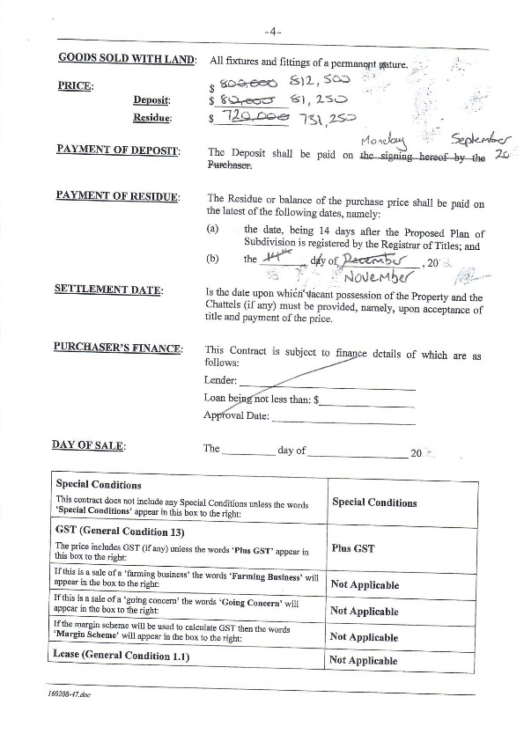
GST claim
Background
Practitioner acted for a purchaser of a new residence. The practitioner knew the purchaser for over 30 years.
Looked like a simple residential purchase.
Contract price $812,500
‘Plus GST’ box separated from the price.
$812,500 was in fact fair market value
Purchaser could not afford the GST.
Claim incurred $86,000.
lplc.com.au
Notes:
I now want to give you an example of a GST claim. Please refer to page 10 of the handout.
In this conveyancing GST claim the lawyer acted for a purchaser of a new residence. The practitioner had known the client for over 30 years. The practitioner reviewed what was a fairly vanilla residential contract of sale.
What the lawyer missed was that the price of $812,500 was plus GST.
What the client believed was that $812,500 was the market value for the property so they were shocked when closer to settlement they were told they had to come with the GST.
Unfortunately the purchaser could not afford the GST.
The claim ended up costing about $86,000.
A case to refer to about the sort of issues we see in GST claims is: A & A Property Developers Pty Ltd v MCCA Asset Management Ltd [2017] VSCA 365
In the contract in this case ‘GST’ was inserted in the relevant box in the particulars of sale instead of ‘plus GST’ as required by general condition 13.
At first instance the court considered pre and post contractual discussions, but they did not clarify the GST position and concluded that the contract price was GST inclusive.
The Court of Appeal overturned this decision and determined that the price was plus GST.
See at paragraph 51:
‘…….there is sufficient indication in the contract that the parties agreed to reverse the default allocation of the risk of liability for GST. I do not consider that the absence of the single word ‘plus’ precludes that conclusion…….’.

Slide 15
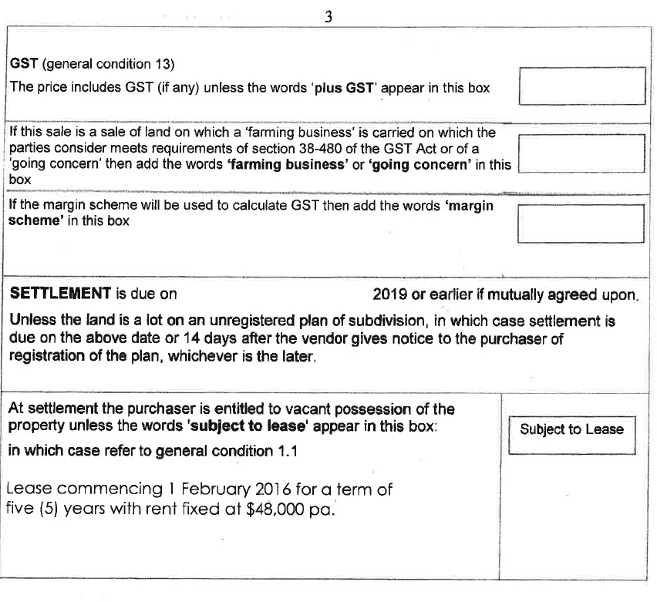
GST quiz
What is the GST issue here?
Notes:
Here is a quick GST quiz for you –
Have a look at this section from the particulars of sale.
What is the GST issue here?
Raise with client whether the supply qualifies as a going concern.
The relevant ATO ruling about going concerns is GSTR 2002/5.
This ruling recognises that a leasing activity on a regular or continuing basis is an enterprise and can be the subject matter of a supply of a going concern. The ruling does not seek to distinguish between multi-tenanted and single-tenanted premises nor to rule out sales of single-tenanted commercial premises as qualifying.
What if the property is vacant and the purchaser wants to put in a tenant? Does this qualify as a going concern?
Is this a leasing enterprise?

Slide 16
Any questions or comments?
lplc.com.au
Notes:
Are there any more questions or comments about GST?

Slide 17
GST special conditions
Example 1
The consideration payable for any taxable supply made under this contract represents the value of the taxable supply for which payment is to be made; Where a taxable supply is made under this contract for consideration which represents its value, then the party liable to pay for the taxable supply must also pay at the same time and in the same manner as the value is otherwise payable the amount of any GST payable in respect of the taxable supply.
Action
List 3 issues you would raise with your purchaser client about GST.
lplc.com.au
Notes:
Let’s now have a look at some GST special special conditions starting from page 11 of the handout.
For almost every contract I prepared I used general condition 13 about GST.
One example of where I included a special condition was where the sale was of a mixed supply. For example, the sale of three titles where one title is vacant land, the other title contains a commercial building leased for use as a warehouse and the third title has a house on it and the vendor resided in the house.
Would you use a special condition for the sale of this property?
I will read this special condition to you:
The consideration payable for any taxable supply made under this contract represents the value of the taxable supply for which payment is to be made; Where a taxable supply is made under this contract for consideration which represents its value, then the party liable to pay for the taxable supply must also pay at the same time and in the same manner as the value is otherwise payable the amount of any GST payable in respect of the taxable supply.
This special condition is from the case of Cityrose Trading Pty Ltd v Booth v Anor [2013] VSC 504.
The property in this case was a new build at 7 Albany Court, Sorrento.
What issues would you raise with the purchaser about GST?
Amount payable
That this special condition is unclear whether the price is plus GST
Seek instructions to request that the vendor clarify the GST position and use general condition 13. General condition 13 was written by LPLC’s Derry Davine.
The matter first came before VCAT and went on appeal to the Supreme Court.
VCAT determined that the contract should be rectified so that the price of $2,250,000 was payable and this included GST.
On appeal the result was the same but for a different reason.
The Supreme Court determined that the Special Condition 7 is void for uncertainty
At paragraph 70 the court determined that in this case, although the parties concluded a bargain for the sale of the property for a price, they did not conclude a bargain for the payment of GST and that it was impossible to place a reasonable meaning on the language used in Special Condition 7 and to discern the parties’ intention with respect to the payment of GST.

Slide 18
GST special conditions
Example 2
In addition to the purchase price the purchaser must pay to the vendor on completion an amount equal to any goods and services tax (GST), value added tax or other tax of a similar nature which is payable or may be payable by the vendor in connection with the sale of the property to the purchaser.
Case
Igloo Homes v Sammut Constructions [2004] NSWSC 1213
lplc.com.au
Notes:
Here is another example of a GST special condition.
This one is from the NSW case of Igloo Homes v Sammut Constructions [2004] NSWSC 1213. I refer to this case on page 12 of the handout.
In addition to the purchase price the purchaser must pay to the vendor on completion an amount equal to any goods and services tax (GST), value added tax or other tax of a similar nature which is payable or may be payable by the vendor in connection with the sale of the property to the purchaser.
The Supreme Court had no hesitation in declaring that this special condition made perfect sense and meant the price was plus GST.

Slide 19
Any questions or comments?
Notes:
Does anyone have any questions or comments about GST which they would like to share with us?

Slide 20
Land tax basics
Main legislation: Land Tax Act 2005 (Vic)
Commencement: Land Tax Act 1877 (Vic)
Imposition: A tax on the value of land owned as at 31 December. There are various rates and a few exemptions.
Deduction: Generally land tax can be claimed as an expense for a rental property for the period the property was rented or available for rent.
lplc.com.au
Notes:
I now want to move on to look at land tax. Please go to page 13 of the handout where you will find some basics.

Slide 21
Land tax – what’s new
Payment of land tax by BPAY:
SRO - from March 2019
Via PEXA - coming soon
Foreigners
Increase in land tax surcharge from 1.5% to 2% for absentee foreign owners for land holdings as at 31 December 2019.
Legislation
State Taxation Acts Amendment Act 2019 (Vic)
lplc.com.au
Notes:
So what’s new with land tax?
You can pay land tax using Bpay.
Soon PEXA will have a designated payment line for land tax.
My final point is about foreigners.
You may have picked up this small change in the budget – the land tax surcharge for foreign owners has increased from 1.5% to 2% for land holdings as at 31 December 2019.

Slide 22
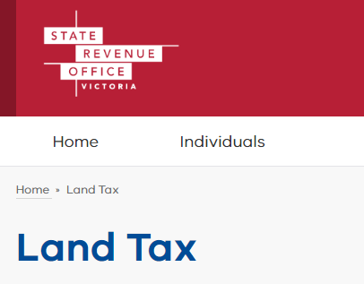
Land tax – examples of claims
Unaware of trust
LTX form 8 not lodged
Knowledge of trust
LTX form 8 not lodged
Lucky it was an SMSF
Trust rate does not apply
lplc.com.au
Notes:
On page 14 you will find details of land tax claims.

Slide 23
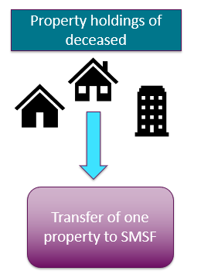
Land tax exercise
Property holdings of deceased
Background
A client of many years passed away in July 2017.
The deceased’s daughter is named as sole executor and instructs you to act in the probate.
It is a very complicated estate with numerous property holdings, trusts and companies that need to be dealt with.
The daughter also seeks advice from you about her entitlement as a beneficiary including whether any land tax will be payable if there is a transfer of one of the properties from the estate to the daughter’s SMSF.
Transfer of one property to SMSF
lplc.com.au
Notes:
Please now go to page 15 where you will find this land tax exercise. This exercise highlights where we have seen some land tax claims.
Here is the background
A client of many years passed away in July 2017.
The deceased’s daughter is named as sole executor and instructs you to act in the probate.
It is a very complicated estate with numerous property holdings, trusts and companies that need to be dealt with.
The daughter also seeks advice from you about her entitlement as a beneficiary including whether any duty will be payable on a transfer of one of the properties from the estate to the daughter’s SMSF.

Slide 24
Land tax exercise
Action
List three land tax issues you would raise with the daughter.
1.
2.
3.
lplc.com.au
Notes:
Here is your call to action
List three land tax issues you would raise with the daughter.
Have a chat with those around you.
A good starting point is section 46E of the Land Tax Act:
A trustee of an administration trust is to be assessed for land tax on the whole of the land subject to the trust as if the land were the only land owned by the trustee.
"administration trust" means a trust under which the assets of a deceased person are held by a personal representative, but only during the period ending on the earlier of—
(a) the completion of administration of the deceased estate; or
(b) the third anniversary of the death of the deceased person or the further period approved by the Commissioner under subsection (3);
Then have a look at - Part 1 of Schedule 1 to the Land Tax Act for the rate of land tax.
What about a transfer from the estate to the SMSF?
The client would certainly need to know the land tax position for the ownership by the SMSF.
Note s. 46E of the Land Tax Act 2005 (Vic). Land tax for a superannuation trust is charged at the general rate.

Slide 25
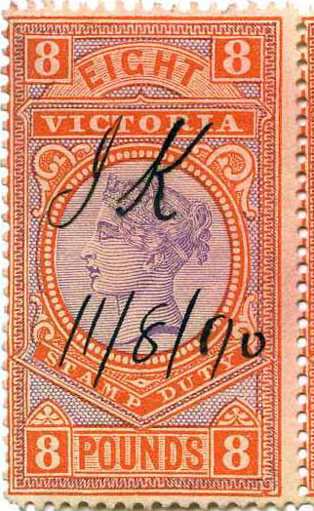
Duty basics
Main legislation: Duty Act 2000 (Vic)
Commencement: Stamp Duties Act 1879 (Vic)
Imposition: Duty payable to the Victorian Government on various transactions including land transfer, declaration of trust and certain leases.
lplc.com.au
Notes:
I am now on page 16 of the handout where you will find some duty basics.
Did you know that the state of Victoria issued revenue stamps from 1870 to 2000.

Slide 26
Duty – what’s new from the budget?
Foreigners
Increase from 7% to 8% additional duty for contracts entered into from 1 July 2019.
Economic entitlements – ‘a fresh head of duty’
State Taxation Acts Amendment Act 2019 (Vic)
Relevant case
BPG Caulfield Village Pty Ltd v Commissioner of State Revenue [2016] VSC 172
More information
https://www.sro.vic.gov.au/economic-entitlements
Notes:
On page 17 you will find details about recent changes to the Duties Act pursuant to the State Taxation Acts Amendment Act 2019 (Vic)
The easier issue to consider is the increase in duty on transfer of land for foreigners.
In addition to the usual duty foreigners will pay a further 8% for contracts entered into from 1 July 2019.
I now want to take you to the most significant change from the budget – a fresh head of duty on economic entitlements.
Changes have been introduced to broaden the type of arrangements which require duty to be paid where there is an acquisition of an economic entitlement.
The definition of economic entitlements has not change but certain hurdles have been removed.
The changes are contained in the new Part 4B of chapter 2 in the Duties Act 2000 (Vic).
The changes take effect from 18 June 2019.
Clients who acquire an economic entitlement from selling, leasing or developing land need to understand the changes and pay any applicable duty within 30 days of the acquisition.
Executive summary
Duty is payable on any arrangement to acquire an ‘economic entitlement’ in relevant land.
Legislation
Amendments were made to duty on economic entitlements pursuant to the State Taxation Acts Amendment Act 2019 (Vic).
You can find this Act, the explanatory memorandum and parliamentary speeches here:
https://www.parliament.vic.gov.au/legislation
Important matters to consider
Commencement date
Any arrangement entered into on or after 18 June 2019. Being the date the State Taxation Acts Amendment Act received assent.
Relevant land
Land in Victoria worth $1,000,000 or more.
Land owner
Any owner of land.
For example, a person, company or trust.
Definition of economic entitlement
Any income, rent, profit, capital growth, or proceeds of sale of any relevant land.
Arrangements caught
The acquisition or receipt either directly or indirectly of an economic entitlement.
Example
Joint venture agreement to develop land where proceeds of sale are split 75/25 between the land owner and the other joint venture party. See below further details about this example.
It is immaterial whether the person who acquires the economic entitlement is a party to the arrangements.
Relevant date
A dutiable transaction occurs when the economic entitlement is acquired, not when the entitlement is realised.
For example, the date of the joint venture agreement to develop land is the date the economic entitlement is acquired.
Amount of duty payable
Ad valorem duty at the same rate payable on a transfer of land.
Date duty due
30 days from the date the economic entitlement is acquired.
For example, within 30 days of entering into a joint venture agreement.
The transaction is treated as a complex transaction for the purpose of assessing duty.
History of duty on economic entitlements
The ‘economic entitlement’ provisions were introduced with effect from 1 July 2012 by the Duties Amendment (Landholder) Act 2012 (Vic).
Old hurdles
Pursuant to the 2012 provisions an economic entitlement could only be acquired where:
the land owner was a private company or private unit trust; and
the economic entitlement amounted to an interest of 50% or more in the private company or private unit trust.
Purpose of 2019 changes to duty on economic entitlements
Parliamentary speech
According to the second reading speech the purpose of the changes to the economic entitlement regime is to address technical issues and gaps consistent with the findings of the Supreme Court's decision in BPG Caulfield Village Pty Ltd v Commissioner of State Revenue [2016] VSC 172.
BPG case
This case is about the land holder provisions in Part 2 of the Duties Act and more specifically the interpretation of s. 81(2)(d) of the Duties Act 2000 (Vic).
Here is a link to a good summary of the case by Hall & Wilcox:
The BPG case provides an example of what was not caught under the 2012 provisions but is now caught under the 2019 provisions.
In this case the Victorian Amateur Turf Club (MRC) and BPG Caulfield Village Pty Ltd (BPG) entered into a Development Agreement in relation to the development of the Caulfield Village (CV Land).
The CV Land comprised:
land owned by MRC (Subject Land); and
land owned by the Crown or by third parties in respect of which MRC had contractual rights.
MRC held an estate in fee simple in:
the Subject Land; and
other lands in the State of Victoria.
The unencumbered value of the Subject Land was $32,550,000.
Pursuant to the Development Agreement:
BPG was appointed to carry out the development of the CV Land;
the CV Land was to be sold to third parties as it was developed; and
BPG was entitled to participate in the proceeds of sale of the CV Land. The extent of that participation was to be calculated in accordance with the terms of the Development Agreement.
By a notice of assessment dated 29 August 2013 Commissioner assessed BPG to pay duty on the acquisition of an economic entitlement under s 81 of the Duties Act.
By a notice of objection dated 24 October 2013, BPG objected to the Assessment.
Justice Croft upheld the objection as the economic entitlement did not amount to an interest of 50% or more.
Further historical information
For further information about the history of these provisions refer to the excellent summary by Justice Croft in the case of BPG Caulfield Village Pty Ltd v Commissioner of State Revenue [2016] VSC 172 at paragraphs 19-30.
Explanatory memorandum
According to the explanatory memorandum:
Clause 13 of the Bill amends section 81 of the Duties Act 2000.
Section 81 contains the existing economic entitlement provisions that are part of the landholder regime in Part 2 of Chapter 3. The section has been amended as a result of the insertion of new economic entitlement provisions in new Part 4B of Chapter 2 of the Duties Act 2000.
Subclause (1) amends the heading to section 81.
Subclause (2) repeals section 81(1)(b), (c) and (d). The repealed paragraphs refer to economic entitlements to income, rent, profits, capital growth, and proceeds of sale of land holdings. These matters are now addressed under new Part 4B of Chapter 2.
Section 81 will continue to apply when an economic entitlement currently referred to in section 81(2)(a) is acquired, being an economic entitlement to participate in the dividends or income of a private landholder. This entitlement relates to the private landholder itself rather than any particular land so it will remain subject to the landholder duty provisions.
Subclause (3) substitutes sections 81(3) and 81(4) stating that the interest acquired under an economic entitlement, for the purposes of section 81, is the proportion of the total dividends or income of the private landholder that a person is entitled to receive under the economic entitlement.
As the amended section 81 only deals with one form of economic entitlement, a provision such as section 81(4) that concerns 2 or more entitlements is no longer necessary.
Further example of what is caught
Here is a summary of an example from the State Revenue Office (SRO) of an arrangement which is dutiable as an economic entitlement:
Joe obtains planning approval to subdivide part of his farm into 55 residential lots for sale to third parties.
The farm is valued at $4.5 million.
On 1 July 2019 Joe enters into a joint venture with Company B so that company B will arrange the development and sales.
The gross proceeds from the sale of the lots will be split 75% to Joe and 25% to Company B.
Duty is charged on the joint venture agreement on a dutiable value of $1.125 million, being 25% of the value of the farm upon entering into the joint venture.
The joint venture agreement is lodged as a complex transaction and duty will be assessed of $61,875 or $151,875 if Company B is a foreign corporation.
Duty is payable within 30 days of entering into the joint venture agreement.
Other arrangements which may be caught
Same scenario as the joint venture above by where:
Joe and the company are registered on title as tenants in common in equal shares.
Joe and the company enter into a JV and agree to develop the land but the company will receive 75% of the proceeds.
A binding legal agreement about the financial arrangements on the breakdown of a marriage or de facto relationship.
The provision of services by an executor to distribute an estate where the assets of the estate include land. See comments below from the SRO about these types of services.
A shareholder agreement where the company owns land and the shareholders agree to develop the land and split the proceeds of sale.
Assignment of rent. This commonly arises where a mortgagee requires the land owner to assign any rent received from any tenant of the land in the event of a default on the mortgage by the land owner.
Option to purchase land.
Appointment of real estate agent to sell land where the agent is associated with the land owner and the fee payable to the agent is outside the industry parameters. See comments below from the SRO about these types of services.
Appointment of real estate agent to manage a leased property where the fee payable to the agent is outside the industry parameters. See comments below from the SRO about these types of services.
Appointment of an owners corporation manager where the fee payable to the OC manager is outside the industry parameters. See comments below from the SRO about these types of services.
SRO position on services provided in relation to land
The SRO has published the following information on its website:
‘………where a person providing a service in relation to land:
is normally engaged in a full time capacity in providing those services,
the agreed fee/rate is within industry parameters, and
the person is unconnected (i.e. not an associated person) to any other person who has an economic entitlement in relation to the land,
it is unnecessary for the service agreement to be disclosed to the State Revenue Office by the service provider……’
This carve out is not contained in the amending legislation.
What you should do now
Read the provisions about the changes to the duty payable on economic entitlement in the State Taxation Acts Amendment Act 2019 (Vic).
You can find this Act, the explanatory memorandum and parliamentary speeches here:
https://www.parliament.vic.gov.au/legislation
Link to information on the new economic entitlement provisions on the SRO website:
https://www.sro.vic.gov.au/economic-entitlements
Link to information on the economic entitlement provisions that have been retained in the Landholder Duty regime on the SRO website :
https://www.sro.vic.gov.au/node/1425
If asked to advise on an acquisition of an economic entitlement arising from selling, leasing or developing land provide details to the client about the new regime and highlight that duty may be payable.
Clients also need to know that they only have thirty days to pay the duty from the date of acquisition otherwise penalties and interest may be payable.

Slide 27
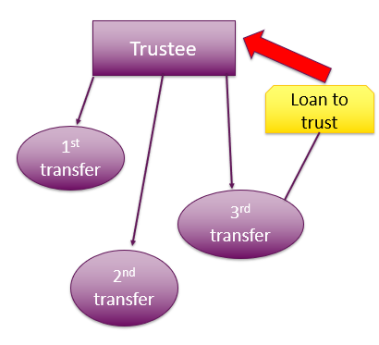
Duty exercise
Trustee
Background
The trustee of a family trust instructs you to transfer a property to a son who is a specified beneficiary.
This is the third such transfer by the trustee. The previous two transfers were to the other two children of the trustee.
The client provides you with the usual information about the transfer including details of a loan account between the trust and the son.
Loan to trust
1st transfer
3rd transfer
2nd transfer
lplc.com.au
Notes:
I now want to move on to page 19 of my handout where you will find a duty exercise.
In this exercise – imagine that the trustee of a family trust instructs you to transfer a property to a son who is a specified beneficiary.
This is the third such transfer by the trustee. The previous two transfers were to the other two children of the trustee.
The client provides you with the usual information about the transfer including details of a loan account between the trust and the son.

Slide 28
Duty exercise
Action
What duty issues would you raise with the trustee?
lplc.com.au
Notes:
Over to you:
What duty issues would you raise with the trustee?
Section 36A of the Duties Act contains an exemption for the transfer of dutiable property from a trustee to a beneficiary.
However, the Commissioner must be satisfied that there was not consideration for the transfer.
You will find on the SRO website detailed notes about transfers to beneficiaries including a list of information to be provided:
For example, you need to provide details of any funds borrowed by the trust from a beneficiary.
Why is the commissioner asking this question?

Slide 29
Do you have any feedback for me?
lplc.com.au
Notes:
This slide is just to remind me to tell you that you will be receiving a survey monkey so you can give us your feedback about today.

Slide 30
Conveyancing tax issues
Phil Nolan
Notes:
Before I bid you farewell I would like to remind you of my three key points:
Develop, use and update a checklist about tax issues
Invest in some good resources or current books on taxes and consult them regularly
Take some time to read cases about taxes
Thanks for participating.

