Slide 1
Behaviour in settlement negotiations
Securing the risks in mortgage matters
Matthew Rose, Risk Manager, LPLC
Matthew Rose, Risk Manager, LPLC

Slide 2
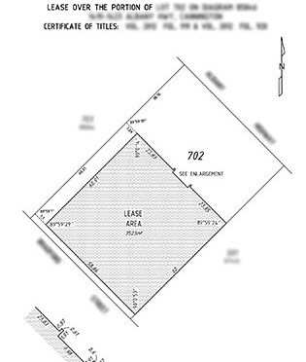
What lease?
Define scope of work in writing
Look for – and advise on – leases
Advise on any unusual terms

Slide 3
Whose job was it?
Be clear about your retainer when other advisors are involved
Look for – and advise on – zoning issues and restrictive covenants
Don’t just assume someone else will do it

Slide 4
Can you find me a lender?
Do not act for both parties
Write to unrepresented parties to clarify
Scope the retainer, address all risks and document advice even where client is sophisticated
Multiple clients – ensure you advise all clients and consider potential conflicts

Slide 5
All looks ok
Think about what is different for each matter
Don’t make assumptions about assets, financial position, priority deed etc
Supervise staff proactively

Slide 6
The Bank of Mum and Dad
Don’t act for all parties – tell non-clients in writing to get independent advice
Recommend the document covers everything an arm’s length agreement would
Address the issue of security
Don’t treat the matter informally
Don’t assume the happy family will remain that way

Slide 7
Vendor finance!
Beware of last-minute deals and informality
Advise against deferring consideration for purchase price
Address the issue of security properly – or scope it out
Conduct necessary searches

